Slide 1
Introduction to Data Science
John P Dickerson
Lecture #15 – 10/19/2021
CMSC320
Tuesdays & Thursdays
5:00pm – 6:15pm https://cmsc320.github.io/

Slide 2
Announcements
Mini-Project #1 grades are out!
Mini-Project #2 was due last night!
Mini-Project #3 will be out soon.
Takes a bit of time – ML + optimization
Due slightly after the second midterm (probably Nov 23rd)
Second midterm data was announced on Piazza about a week ago:
Second midterm: November 18th
Also on the course webpage
Discussion.

Slide 3
Common issue With Project 1
A value is trying to be set on a copy of a slice from a DataFrame
Often not a problem! But, sometimes a problem …
Example:
df[df[‘intensity’] > 0.1][‘color’] = ‘red’
??????????
This will not set a value in df – assignment is chained
Instead, use df.loc[df[‘intensity’] > 0.1, ‘color’] = ‘red’

Slide 4
And now:
Words words words!
Free text and natural language processing in data science
Bag of words and TF-IDF
N-Grams and language models
Sentiment mining
Thanks to: Zico Kolter (CMU) & Marine Carpuat’s 723 (UMD)

Slide 5
Precursor to Natural language processing
For we can easily understand a machine's being constituted so that it can utter words, and even emit some responses to action on it of a corporeal kind, which brings about a change in its organs; for instance, if touched in a particular part it may ask what we wish to say to it; if in another part it may exclaim that it is being hurt, and so on.
(But it never happens that it arranges its speech in various ways, in order to reply appropriately to everything that may be said in its presence, as even the lowest type of man can do.)
-- René Descartes, 1600s
Notes:
Precursor to the Turing Test – Descartes seems to think we’ll never pass it

Slide 6
Precursor to Natural Language processing
Turing’s Imitation Game [1950]:
Person A and Person B go into separate rooms
Guests send questions in, read questions that come out – but they are not told who sent the answers
Person A (B) wants to convince group that she is Person B (A)
We now ask the question, "What will happen when a machine takes the part of [Person] A in this game?" Will the interrogator decide wrongly as often when the game is played like this as he does when the game is played between [two humans]? These questions replace our original, "Can machines think?"

Slide 7
Precursor to Natural language processing
Mechanical translation started in the 1930s
Largely based on dictionary lookups
Georgetown-IBM Experiment:
Translated 60 Russian sentences to English
Fairly basic system behind the scenes
Highly publicized, system ended up spectacularly failing
Funding dried up; not much research in “mechanical translation” until the 1980s …

Slide 8
Statistical Natural Language Processing
Pre-1980s: primarily based on sets of hand-tuned rules
Post-1980s: introduction of machine learning to NLP
Initially, decision trees learned what-if rules automatically
Then, hidden Markov models (HMMs) were used for part of speech (POS) tagging
Explosion of statistical models for language
Recent work focuses on purely unsupervised or semi-supervised learning of models
We’ll cover some of this in the machine learning lectures!

Slide 9
NLP in Data Science
In Mini-Project #1, you used requests and BeautifulSoup to scrape structured data from the web
Lots of data come as unstructured free text: ???????????
Facebook posts
Amazon Reviews
Wikileaks dump
Data science: want to get some meaningful information from unstructured text
Need to get some level of understanding what the text says

Slide 10
Understanding language is hard
One morning I shot an elephant in my pajamas.
How he got into my pajamas, I'll never know.
Groucho Marx
?

Slide 11
Understanding language is hard
The Winograd Schema Challenge:
Proposed by Levesque as a complement to the Turing Test
Formally, need to pick out the antecedent of an ambiguous pronoun:
Levesque argues that understanding such sentences requires more than NLP, but also commonsense reasoning and deep contextual reasoning
The city councilmen refused the demonstrators a permit because they [feared/advocated] violence.
Terry Winograd

Slide 12
Understanding language is hard?
I haven't played it that much yet, but it's shaping to be one of the greatest games ever made! It exudes beauty in every single pixel of it. It's a masterpiece. 10/10
fabchan, March 3, 2017, Metacritic
a horrible stupid game,it's like 5 years ago game,900p 20~30f, i don't play this **** anymore it's like someone give me a **** to play ,no this time sorry,so Nintendo go f yourself pls
Nsucks7752, March 6, 2017, Metacritic
Perhaps we can get some signal (in this case, sentiment) without truly understanding the text …

Slide 13
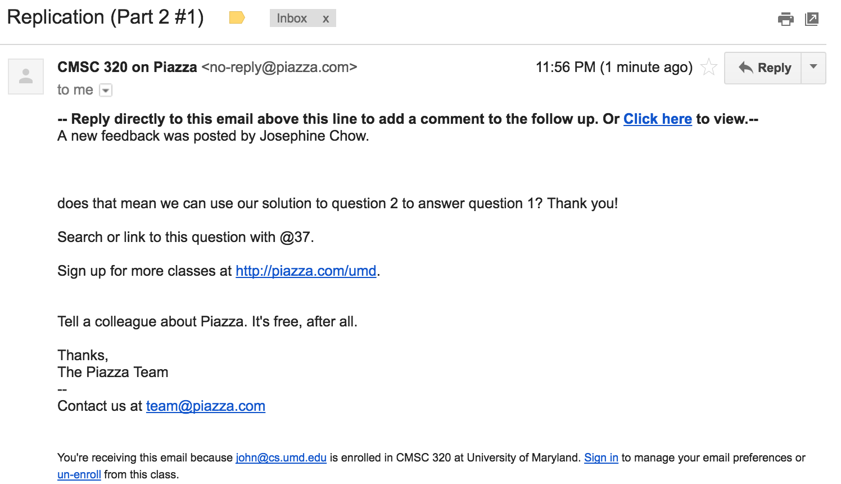
“Some Signal”
or
Possible signals ?????????

Slide 14

“Some Signal”
What type of article is this?
Sports
Political
Dark comedy
Reality TV
What entities are covered?
And are they covered with positive or negative sentiment?
Possible signals ????????

Slide 15
Aside: Terminology
Documents: groups of free text
Actual documents (NYT article, journal paper)
Entries in a table
Corpus: a collection of documents
Terms: individual words
Separated by whitespace or punctuation

Slide 16
NLP Tasks
Syntax: refers to the grammatical structure of language
The rules via which one forms sentences/expressions
Semantics: the study of meaning of language
John is rectangular and a rainbow.
Syntactically correct
Semantically meaningless

Slide 17
Syntax
Tokenization
Splitting sentences into tokens
Lemmatization/Stemming
Turning “organizing” and “organized” into “organiz”
Morphological Segmentation
How words are formed, and relationships of different parts
Easy for English, but other languages are difficult
Part-of-speech (POS) Tagging
Determine whether a word is a noun/adverb/verb etc.
Parsing
Create a “parse tree” for a sentence

Slide 18
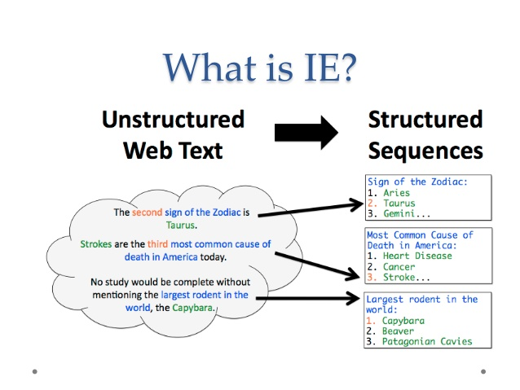
Semantics: information extraction

Slide 19
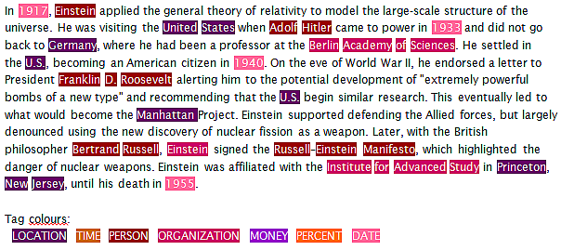
Semantics: named entity recognition
Identifying key entities in text

Slide 20
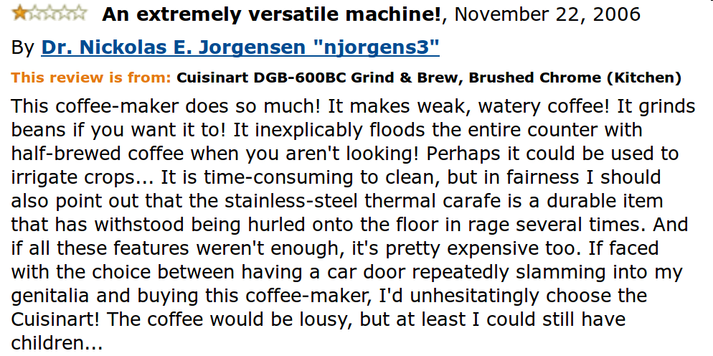
Semantics: sentiment analysis
Deciding if reviews/opinions are positive or negative
Heavily used by ad industry today

Slide 21
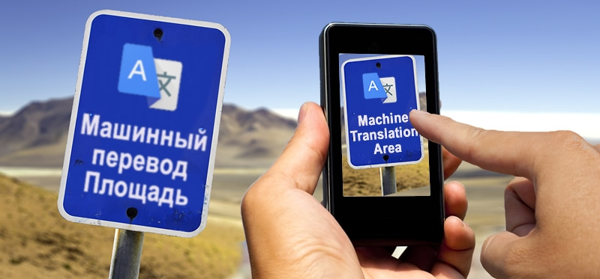
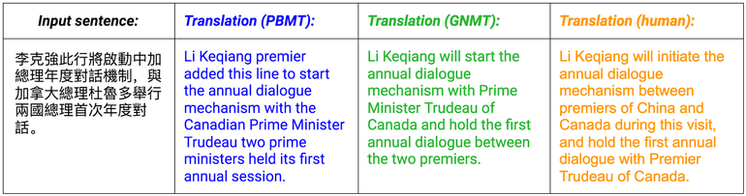
Semantics: Machine translation
Translating from one language to another
Simple substitution of words doesn’t work very well
(Image: Google)

Slide 22
Semantics: Machine translation
0> how long before the next flight to Alice Springs?
1> wie lang vor dem folgenden Flug zu Alice Springs?
2> how long before the following flight to Alice jump?
3> wie lang vor dem folgenden Flug zu Alice springen Sie?
4> how long before the following flight to Alice do you jump?
5> wie lang, bevor der folgende Flug zu Alice tun, Sie springen?
6> how long, before the following flight to Alice does, do you jump?
7> wie lang bevor der folgende Flug zu Alice tut, tun Sie springen?
8> how long before the following flight to Alice does, do you jump?
9> wie lang, bevor der folgende Flug zu Alice tut, tun Sie springen?
10> how long, before the following flight does to Alice, do do you jump?
11> wie lang bevor der folgende Flug zu Alice tut, Sie tun Sprung?
12> how long before the following flight does leap to Alice, does you?
From NLTK Book

Slide 23

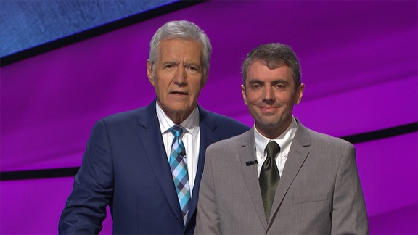
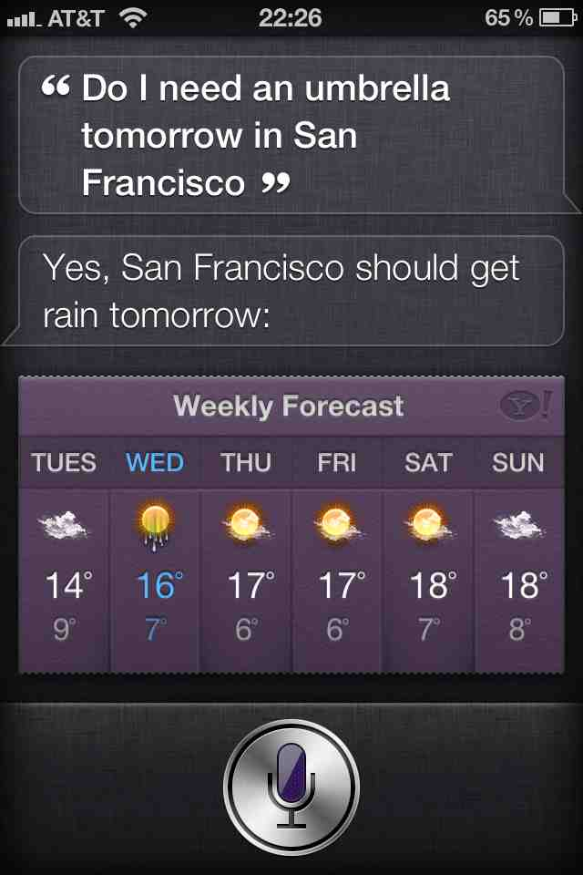
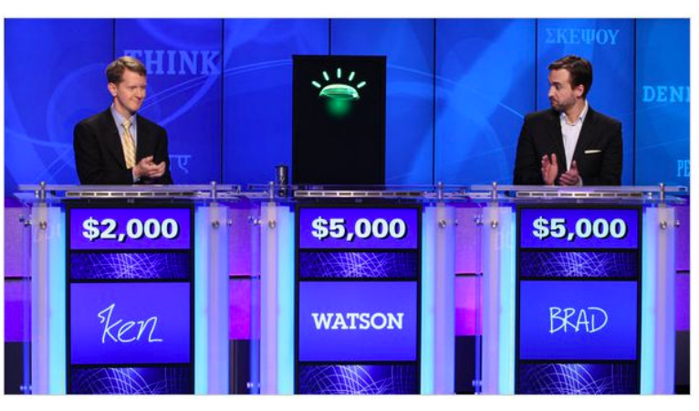
Semantics: question answering
Answer questions posed a user with specific answers
Learn more from UMD Prof Jordan Boyd-Graber Ying, NLP Researcher & Jeopardy Contestant!
WILLIAM WILKINSON’S
“AN ACCOUNT OF THE PRINCIPALITIES OF WALLACHIA AND MOLDOVIA”
INSPIRED THIS AUTHOR’S
MOST FAMOUS NOVEL
Bram Stoker

Slide 24
Semantics: question answering
Answer questions posed a user with specific answers
Factoid questions
Who wrote “The Universal Declaration of Human Rights”?
How many calories are there in two slices of apple pie?
What is the average age of the onset of autism?
Where is Apple Computer based?
Complex (narrative) questions:
In children with an acute febrile illness, what is the efficacy of acetaminophen in reducing fever?
What do scholars think about Jefferson’s position on dealing with pirates?

Slide 25
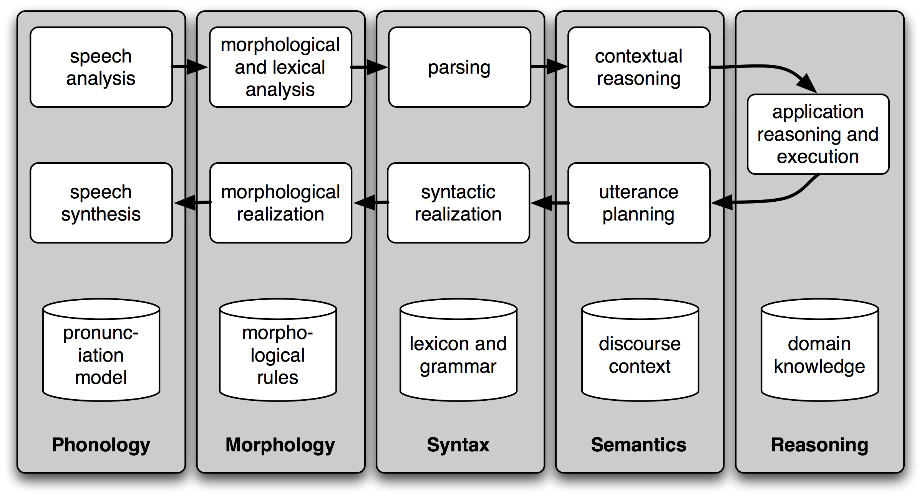
Semantics: Spoken Dialogue Systems

Slide 26
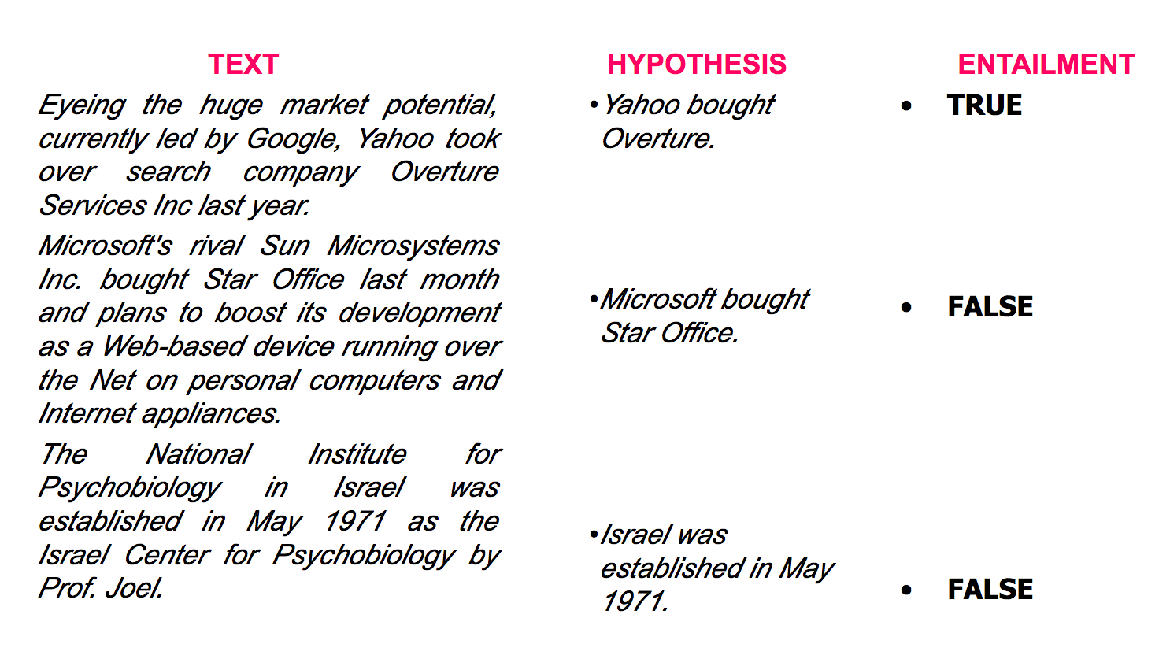
Semantics: textual entailment
Given two text fragments, determine if one being true entails the other, entails the other's negation, or allows the other to be either true or false

Slide 27
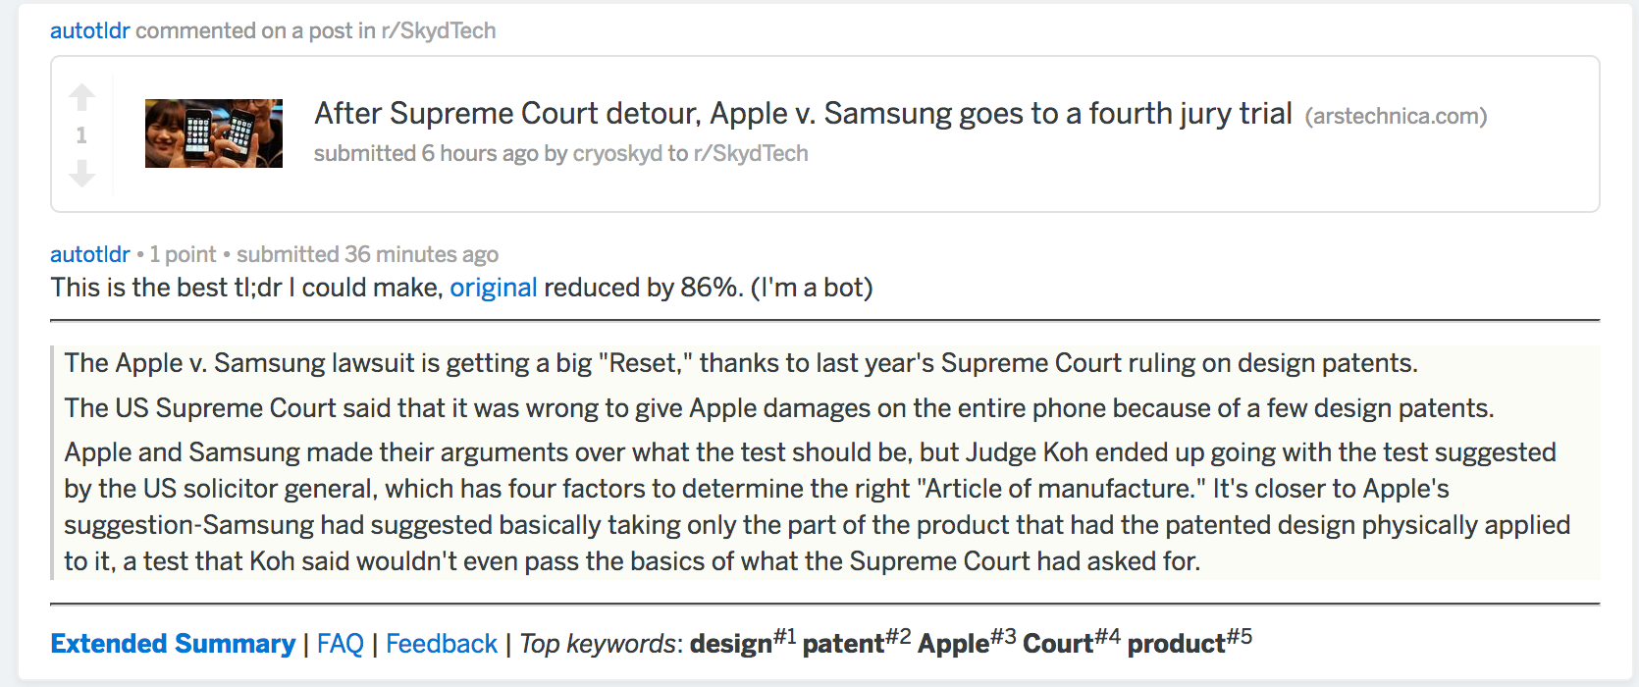
Semantics: document summarization
Quite a few tools out there today… e.g., SMMRY

Slide 28
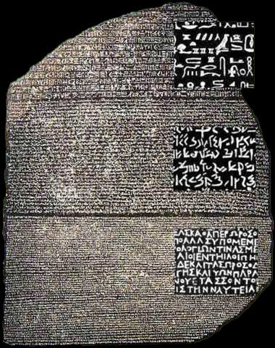
Other tasks
Speech Recognition
Caption Generation
Natural Language Generation
Optical Character Recognition
Word Sense Disambiguation
serve: help with food or drink; hold an office; put ball into play
…
Doing all of these for many different languages

Slide 29
Semantics: Text classification
Is it spam?
Who wrote this paper? (Author identification)
https://en.wikipedia.org/wiki/The_Federalist_Papers#Authorship
https://www.uwgb.edu/dutchs/pseudosc/hidncode.htm
¡Identificación del idioma!
Sentiment analysis
What type of document is this?
When was this document written?
Readability assessment

Slide 30
Text classification
Input:
A document w
A set of classes Y = {y₁, y₂, …, y_{J}}
Output:
A predicted class y ∈ Y
(You will spend much more time on classification problems throughout the CMSC320, CMSC421, CMSC422, etc. program, this is just a light intro!)

Slide 31
Text classification
Hand-coded rules based on combinations of terms (and possibly other context)
If email w:
Sent from a DNSBL (DNS blacklist) OR
Contains “Nigerian prince” OR
Contains URL with Unicode OR …
Then: y_{w} = spam
Pros: ?????????
Domain expertise, human-understandable
Cons: ?????????
Brittle, expensive to maintain, overly conservative

Slide 32
Text classification
Input:
A document w
A set of classes Y = {y₁, y₂, …, y_{J}}
A training set of m hand-labeled documents {(w₁, y₁), (w₂, y₂), …, (w_{m}, y_{m})}
Output:
A learned classifier w → y
This is an example of supervised learning

Slide 33
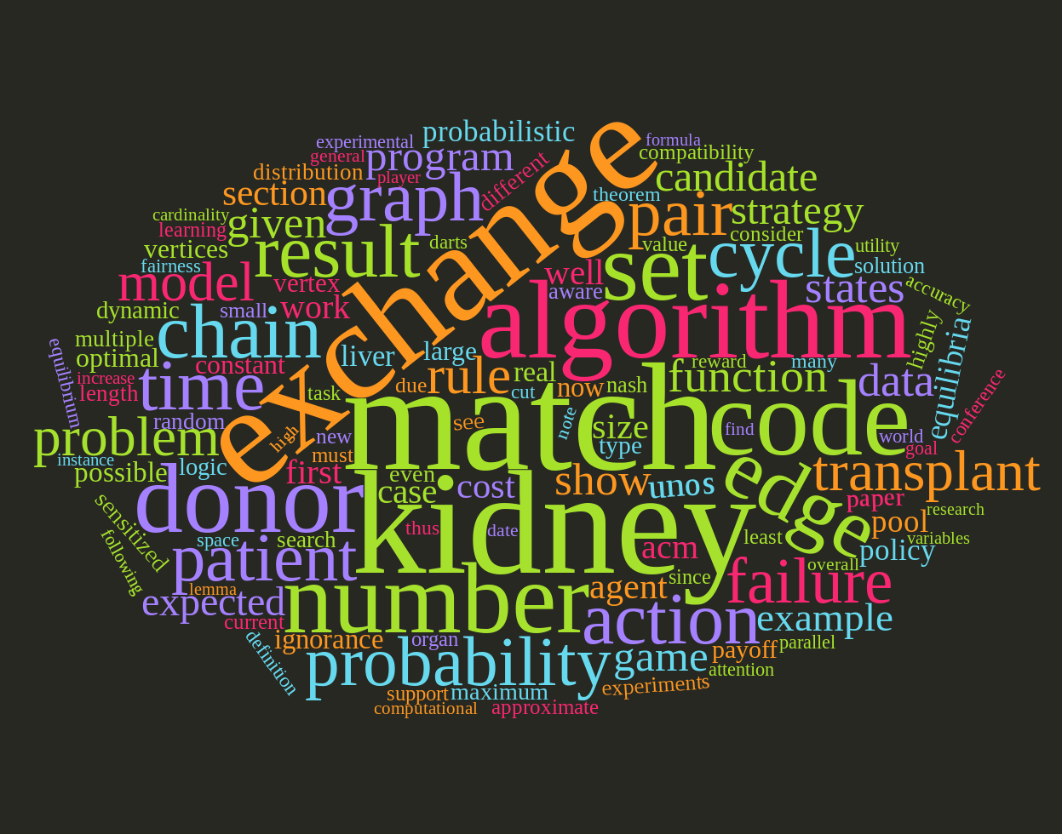
Representing a document “in math”
Simplest method: bag of words
Represent each document as a vector of word frequencies
Order of words does not matter, just #occurrences

Slide 34
Bag of words Example
the quick brown fox jumps over the lazy dog
I am he as you are he as you are me
he said the CMSC320 is 189 more CMSCs than the CMSC131
the | CMSC320 | you | he | I | quick | dog | me | CMSCs | … | than
2 | 0 | 0 | 0 | 0 | 1 | 1 | 0 | 0 | … | 0
0 | 0 | 2 | 2 | 1 | 0 | 0 | 1 | 0 |  | 0
2 | 1 | 0 | 1 | 0 | 0 | 0 | 0 | 1 |  | 1
Document 1
Document 2
Document 3

Slide 35
Term Frequency
Term frequency: the number of times a term appears in a specific document
tf_{ij}: frequency of word j in document i
This can be the raw count (like in the BOW in the last slide):
tf_{ij} ∈ {0,1} if word j appears or doesn’t appear in doc i
log(1 + tf_{ij}) – reduce the effect of outliers
tf_{ij} / max_{j} tf_{ij} – normalize by document i’s most frequent word
What can we do with this?
Use as features to learn a classifier w → y …!

Slide 36
Defining features From Term Frequency
Suppose we are classifying if a document was written by The Beatles or not (i.e., binary classification):
Two classes y ∈ Y = { 0, 1 } = { not_beatles, beatles }
Let’s use tf_{ij} ∈ {0,1}, which gives:
Then represent documents with a feature function: f(x, y = not_beatles = 0) = [x^{T}, 0^{T}, 1]^{T} f(x, y = beatles = 1) = [0^{T}, x^{T}, 1]^{T}
the | CMSC320 | you | he | I | quick | dog | me | CMSCs | … | than
1 | 0 | 0 | 0 | 0 | 1 | 1 | 0 | 0 | … | 0
0 | 0 | 1 | 1 | 1 | 0 | 0 | 1 | 0 |  | 0
1 | 1 | 0 | 1 | 0 | 0 | 0 | 0 | 1 |  | 1
x₁^{T} =
y₁ = 0
x₂^{T} =
y₂ = 1
x₃^{T} =
y₃ = 0

Slide 37
Linear classification
We can then define weights θ for each feature
θ = { <CMSC320, not_beatles> = +1, <CMSC320, beatles> = -1, <walrus, not_beatles> = -0.3, <walrus, beatles> = +1, <the, not_beatles> = 0, <the, beatles>, 0, … }
Write weights as vector that aligns with feature mapping
Score 𝝍 of an instance x and class y is the sum of the weights for the features in that class:
𝝍_{xy} = Σ θ_{n} f_{n}(x, y)
= θ^{T} f(x, y)

Slide 38
Linear classification
We have a feature function f(x, y) and a score 𝝍_{xy} = θ^{T} f(x, y)
And return the class with highest score!
Compute the score of the document for that class
For each class y ∈ { not_beatles, beatles }
Where did these weights come from? We’ll talk about this in the ML lectures …
(… and also this whole “linear classifier” thing.)

Slide 39
Explicit Example
We are interested in classifying documents into one of two classes y ∈ Y = { 0, 1 } = { hates_cats, likes_cats}
Document 1: I like cats
Document 2: I hate cats
Now, represent documents with a feature function: f(x, y = hates_cats = 0) = [x^{T}, 0^{T}, 1]^{T} f(x, y = likes_cats = 1) = [0^{T}, x^{T}, 1]^{T}
I | like | hate | cats
1 | 1 | 0 | 1
1 | 0 | 1 | 1
x₁^{T} =
y₁ = ?
x₂^{T} =
y₂ = ?

Slide 40
Explicit Example
I | like | hate | cats
1 | 1 | 0 | 1
1 | 0 | 1 | 1
f(x, y = 0) = [x^{T}, 0^{T}, 1]^{T} f(x, y = 1) = [0^{T}, x^{T}, 1]^{T}
x₁^{T} =
y₁ = ?
x₂^{T} =
y₂ = ?
y=0: hates_cats
y=1: likes_cats
(1)
I | like | hate | cats | I | like | hate | cats | --
1 | 1 | 0 | 1 | 0 | 0 | 0 | 0 | 1
0 | 0 | 0 | 0 | 1 | 1 | 0 | 1 | 1
1 | 0 | 1 | 1 | 0 | 0 | 0 | 0 | 1
0 | 0 | 0 | 0 | 1 | 0 | 1 | 1 | 1
f(x₁, y = hates_cats = 0) =
f(x₁, y = likes_cats = 1) =
f(x₂, y = hates_cats = 0) =
f(x₂, y = likes_cats = 1) =

Slide 41
Explicit Example
Now, assume we have weights θ for each feature
θ = { <I, hates_cats> = 0, <I, likes_cats> = 0,
<like, hates_cats> = -1, <like, likes_cats> = +1,
<hate, hates_cats> = +1, <hate, likes_cats> = -1,
<cats, hates_cats> = -0.1, <cats, likes_cats = +0.5> }
Write weights as vector that aligns with feature mapping:
y=0: hates_cats
y=1: likes_cats
(1)
Parameter vector θ ^{T} =
0 | -1 | 1 | -0.1 | 0 | 1 | -1 | 0.5 | 1
I | like | hate | cats | I | like | hate | cats | --
1 | 1 | 0 | 1 | 0 | 0 | 0 | 0 | 1
0 | 0 | 0 | 0 | 1 | 1 | 0 | 1 | 1
1 | 0 | 1 | 1 | 0 | 0 | 0 | 0 | 1
0 | 0 | 0 | 0 | 1 | 0 | 1 | 1 | 1
f(x₁, y = hates_cats = 0) =
f(x₁, y = likes_cats = 1) =
f(x₂, y = hates_cats = 0) =
f(x₂, y = likes_cats = 1) =

Slide 42
Explicit example
Score 𝝍 of an instance x and class y is the sum of the weights for the features in that class:
𝝍_{xy} = Σ θ_{n} f_{n}(x, y)
= θ^{T} f(x, y)
Let’s compute 𝝍_{x1,y=hates_cats} …
𝝍_{x1,y=hates_cats} = θ^{T} f(x₁, y = hates_cats = 0)
= 0*1 + -1*1 + 1*0 + -0.1*1 + 0*0 + 1*0 + -1*0 + 0.5*0 + 1*1
= -1 - 0.1 + 1 = -0.1
1 | I
1 | like
0 | hate
1 | cats
0 | I
0 | like
0 | hate
0 | cats
1 | –
hates_cats
likes_cats
(1)
θ ^{T} =
0 | -1 | 1 | -0.1 | 0 | 1 | -1 | 0.5 | 1
f(x₁, y = 0)

Slide 43
Explicit example
Saving the boring stuff:
𝝍_{x1,y=hates_cats} = -0.1; 𝝍_{x1,y=likes_cats} = +2.5
𝝍_{x2,y=hates_cats} = +1.9; 𝝍_{x2,y=likes_cats} = +0.5
We want to predict the class of each document:
Document 1: argmax{ 𝝍_{x1,y=hates_cats}, 𝝍_{x1,y=likes_cats} } ????????
Document 2: argmax{ 𝝍_{x2,y=hates_cats}, 𝝍_{x2,y=likes_cats} } ????????
Document 1: I like cats
Document 2: I hate cats

Slide 44
Inverse Document Frequency
Recall:
tf_{ij}: frequency of word j in document i
Any issues with this ??????????
Term frequency gets overloaded by common words
Inverse Document Frequency (IDF): weight individual words negatively by how frequently they appear in the corpus:
IDF is just defined for a word j, not word/document pair j, i

Slide 45
Inverse Document Frequency
the | CMSC320 | you | he | I | quick | dog | me | CMSCs | … | than
2 | 0 | 0 | 0 | 0 | 1 | 1 | 0 | 0 | … | 0
0 | 0 | 2 | 2 | 1 | 0 | 0 | 1 | 0 |  | 0
2 | 1 | 0 | 1 | 0 | 0 | 0 | 0 | 1 |  | 1
Document 1
Document 2
Document 3

Slide 46
TF-IDF
How do we use the IDF weights?
Term frequency inverse document frequency (TF-IDF):
TF-IDF score: tf_{ij} x idf_{j}
This ends up working better than raw scores for classification and for computing similarity between documents.
the | CMSC320 | you | he | I | quick | dog | me | CMSCs | … | than
0.8 | 0 | 0 | 0 | 0 | 1.1 | 1.1 | 0 | 0 | … | 0
0 | 0 | 2.2 | 0.8 | 1.1 | 0 | 0 | 1.1 | 0 |  | 0
0.8 | 1.1 | 0 | 0.4 | 0 | 0 | 0 | 0 | 1.1 |  | 1.1
Document 1
Document 2
Document 3

Slide 47
Tokenization
First step towards text processing
For English, just split on non-alphanumerical characters
Need to deal with cases like: I’m, or France’s, or Hewlett-Packard
Should “San Francisco” be one token or two?
Other languages introduce additional issues
L'ensemble → one token or two?
German noun compounds are not segmented
Lebensversicherungsgesellschaftsangestellter
Chinese/Japanese more complicated because of white spaces

Slide 48
Other basic terms
Lemmatization
Reduce inflections or variant forms to base form
am, are, is → be
car, cars, car's, cars' → car
the boy's cars are different colors → the boy car be different color
Morphology/Morphemes
The small meaningful units that make up words
Stems: The core meaning-bearing units
Affixes: Bits and pieces that adhere to stems
Often with grammatical functions
Notes:
Morphology (from ResearchGate thread)
dis-agree-ment is a noun, which is formed by means of the suffix -ment from the verb dis-agree, which itself is formed by means of the prefix dis- from the verb /agree/. Note that morphological derivations (nearly) always combine morphemes, which have a meaning and belong to some category. In this case, /agree/ is the only element that can freely occur - thus, /agree/ must be the core element or root. However, roots can be projected on stems, and stems can be projected on words without any specific marking. It is more important to analyze the steps of derivation according to the category and meaning of the parts than to classify the parts into arbitrary classes like roots or stems.

Slide 49
Stemming
Reduce terms to their stems in information retrieval
Stemming is crude chopping of affixes
language dependent
e.g., automate(s), automatic, automation all reduced to automat.
for example compressed
and compression are both
accepted as equivalent to
compress.
for exampl compress and
compress ar both accept
as equival to compress

Slide 50
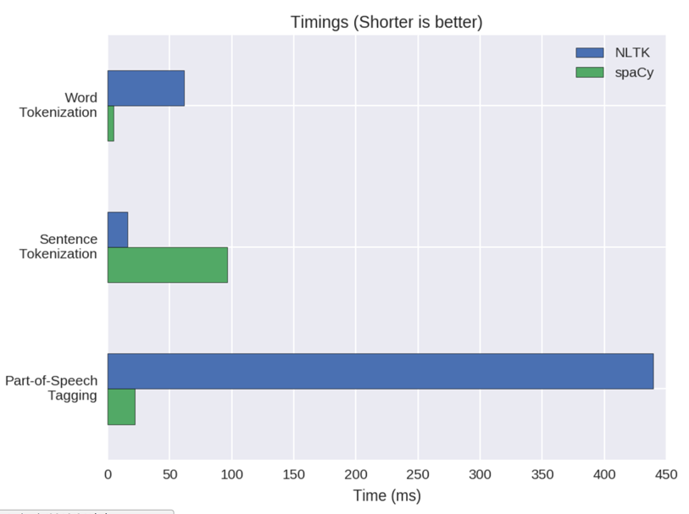
NLP in Python
Two majors libraries for performing basic NLP in Python:
Natural Language Toolkit (NLTK): started as research code, now widely used in industry and research
Spacy: much newer implementation, more streamlined
Pros and cons to both:
NLTK has more “stuff” implemented, is more customizable
This is a blessing and a curse
Spacy is younger and feature sparse, but can be much faster
Both are Anaconda packages

Slide 51
NLTK examples
import nltk
# Tokenize, aka find the terms in, a sentence
sentence = ”A wizard is never late, nor is he early. He arrives precisely when he means to.”
tokens = nltk.word_tokenize(sentence)
LookupError:
**********************************************************************
Resource 'tokenizers/punkt/PY3/english.pickle' not found.
Please use the NLTK Downloader to obtain the resource: >>>
nltk.download()
Searched in:
- '/Users/spook/nltk_data'
- '/usr/share/nltk_data'
- '/usr/local/share/nltk_data'
- '/usr/lib/nltk_data'
- '/usr/local/lib/nltk_data'
- ''
**********************************************************************
Fool of a Took!

Slide 52
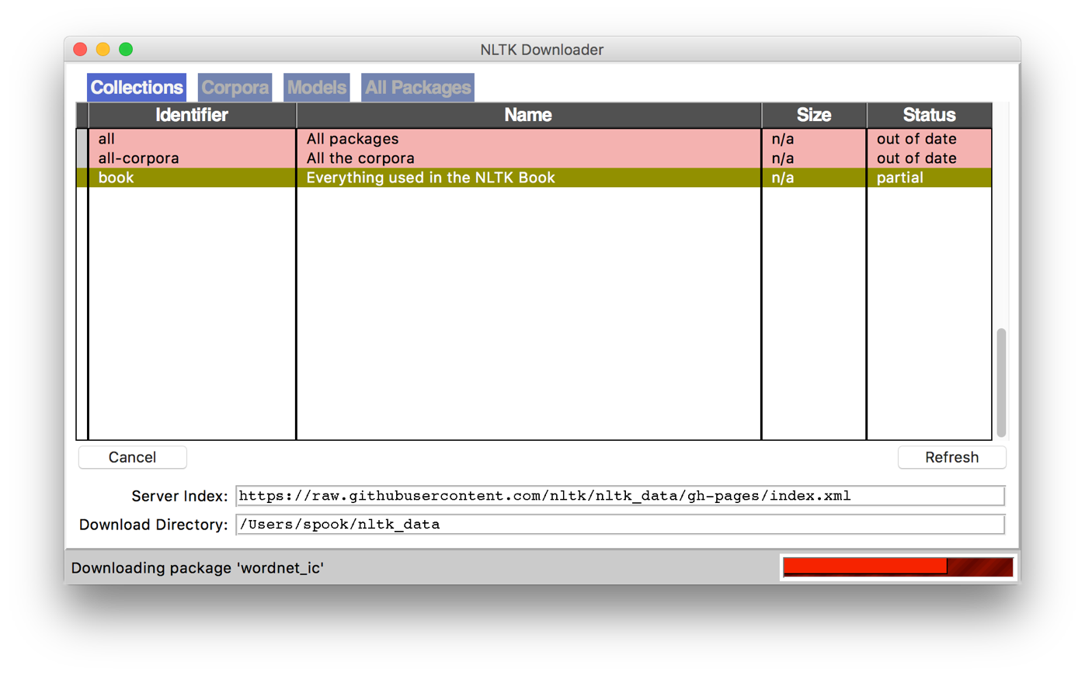
NLTK Examples
Corpora are, by definition, large bodies of text
NLTK relies on a large corpus set to perform various functionalities; you can pick and choose:
# Launch a GUI browser of available corpora
nltk.download()
# Or download everything at once!
nltk.download(“all”)

Slide 53
NLTK Examples
import nltk
# Tokenize, aka find the terms in, a sentence
sentence = ”A wizard is never late, nor is he early. He arrives precisely when he means to.”
tokens = nltk.word_tokenize(sentence)
['A', 'wizard', 'is', 'never', 'late', ',', 'nor', 'is', 'he', 'early', '.', 'He', 'arrives', 'precisely', 'when', 'he', 'means', 'to', '.']
(This will also tokenize words like “o’clock” into one term, and “didn’t” into two term, “did” and “n’t”.)

Slide 54
NLTK Examples
# Determine parts of speech (POS) tags
tagged = nltk.pos_tag(tokens)
tagged[:10]
[('A', 'DT'), ('wizard', 'NN'), ('is', 'VBZ'), ('never', 'RB'), ('late', 'RB'), (',', ','), ('nor', 'CC'), ('is', 'VBZ'), ('he', 'PRP'), ('early', 'RB')]
Abbreviation | POS
DT | Determiner
NN | Noun
VBZ | Verb (3rd person singular present)
RB | Adverb
CC | Conjunction
PRP | Personal Pronoun
Full list: https://cs.nyu.edu/grishman/jet/guide/PennPOS.html

Slide 55
NLTK Examples
# Find named entities & visualize
entities = nltk.chunk.ne_chunk( nltk.pos_tag( nltk.word_tokenize(“”” The Shire was divided into four quarters, the Farthings already referred to. North, South, East, and West; and these again each into a number of folklands, which still bore the names of some of the old leading families, although by the time of this history these names were no longer found only in their proper folklands. Nearly all Tooks still lived in the Tookland, but that was not true of many other families, such as the Bagginses or the Boffins. Outside the Farthings were the East and West Marches: the Buckland (see beginning of Chapter V, Book I); and the Westmarch added to the Shire in S.R. 1462.
“””)))
entities.draw()

Slide 56
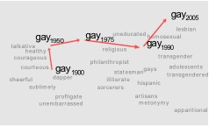
Brief Aside: vector Semantics of Docs/terms
“fast” is similar to “rapid”
“tall” is similar to “height”
Question answering:
Q: “How tall is Mt. Everest?” Candidate A: “The official height of Mount Everest is 29029 feet”
[Kulkarni, Al-Rfou, Perozzi, Skiena 2015]
Many thanks to Dan Jurafsky here!

Slide 57
Distributional models of meaning
Distributional models of meaning = vector-space models of meaning = vector semantics
Intuitions: Zellig Harris (1954):
“oculist and eye-doctor … occur in almost the same environments”
“If A and B have almost identical environments we say that they are synonyms.”
Firth (1957):
“You shall know a word by the company it keeps!”
[DJ]

Slide 58
Intuition of distributional word similarity
A bottle of tesgüino is on the table
Everybody likes tesgüino
Tesgüino makes you burpy
We make tesgüino out of tea and sugar.
From context words humans can guess tesgüino means
A beverage like kombucha
Intuition for algorithm:
Two words are similar if they have similar word contexts.
[DJ]

Slide 59
Four kinds of vector models
Sparse vector representations
Mutual-information weighted word co-occurrence matrices
Dense vector representations:
Singular value decomposition (and Latent Semantic Analysis)
Neural-network-inspired models (skip-grams, CBOW)
Brown clusters
Won’t go into these much – basically, classify terms into “word classes” using a particular clustering method
Hard clustering due to Brown et al. 1992, embed words in some space and cluster. Generally, better methods out there now …
[DJ]

Slide 60
Shared intuition
Model the meaning of a word by embedding in a vector space.
The meaning of a word is a vector of numbers
Vector models are also called “embeddings”.
Contrast: word meaning is represented in many computational linguistic applications by a vocabulary index (“word number 545”)
[DJ]

Slide 61
Reminder: Term-document matrix
Each cell: count of term t in a document d: tf_{t,d}:
Each document is a count vector in ℕ^{v}: a column below
[DJ]

Slide 62
Reminder: Term-document matrix
Two documents are similar if their vectors are similar
[DJ]

Slide 63
The words in a term-document matrix
Each word is a count vector in ℕ^{D}: a row below
[DJ]

Slide 64
The words in a term-document matrix
Two words are similar if their vectors are similar
[DJ]

Slide 65
Term-context matrix for word similarity
Two words are similar in meaning if their context vectors are similar
[DJ]

Slide 66
The word-word or word-context matrix
Instead of entire documents, use smaller contexts
Paragraph
Window of $±$ 4 words
A word is now defined by a vector over counts of context words
Instead of each vector being of length D
Each vector is now of length |V|
The word-word matrix is |V|x|V|, not DxD
[DJ]

Slide 67

Word-Word matrix Sample contexts $±$ 7 words
…
…
[DJ]

Slide 68
Word-word matrix
We showed only 4x6, but the real matrix is 50,000 x 50,000
So it’s very sparse
Most values are 0.
That’s OK, since there are lots of efficient algorithms for sparse matrices.
The size of windows depends on your goals
The shorter the windows , the more syntactic the representation
$±$ 1-3 very syntacticy
The longer the windows, the more semantic the representation
$±$ 4-10 more semanticy
[DJ]

Slide 69
Measuring similarity
Given 2 target words v and w
Need a way to measure their similarity.
Most measure of vectors similarity are based on the:
Dot product or inner product from linear algebra
High when two vectors have large values in same dimensions.
Low (in fact 0) for orthogonal vectors with zeros in complementary distribution
[DJ]

Slide 70
Problem with dot product
Dot product is longer if the vector is longer. Vector length:
Vectors are longer if they have higher values in each dimension
That means more frequent words will have higher dot products
That’s bad: we don’t want a similarity metric to be sensitive to word frequency
[DJ]

Slide 71
Solution: cosine
Just divide the dot product by the length of the two vectors!
This turns out to be the cosine of the angle between them!

Slide 72
Similarity between Documents
Given two documents x and y, represented by their TF-IDF vectors (or any vectors), the cosine similarity is:
Formally, it measures the cosine of the angle between two vectors x and y:
cos(0º) = 1, cos(90º) = 0 ??????????
Similar documents have high cosine similarity; dissimilar documents have low cosine similarity.

Slide 73
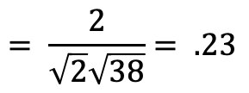
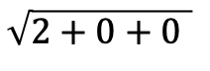
Example
 | large | data | computer
apricot | 2 | 0 | 0
digital | 0 | 1 | 2
information | 1 | 6 | 1
Which pair of words is more similar?
cosine(apricot,information) =
cosine(digital,information) =
cosine(apricot,digital) =
$$2+0+0$$
$$= \frac{2}{\sqrt{2}\sqrt{38}}= .23$$
$$\sqrt{2+0+0 }$$

Slide 74
(Minimum) Edit distance
How similar are two strings?
Many different distance metrics (as we saw earlier when discussing entity resolution
Typically based on the number of edit operations needed to transform from one to the other
Useful in NLP context for spelling correction, information extraction, speech recognition, etc.

Slide 75
Brief Aside: n-grams
n-gram: Contiguous sequence of n tokens/words etc.
Unigram, bigram, trigram, “four-gram”, “five-gram”, …

Slide 76
Language Modeling
Assign a probability to a sentence
Machine Translation:
P(high winds tonite) > P(large winds tonite)
Spell Correction
The office is about fifteen minuets from my house
P(about fifteen minutes from) > P(about fifteen minuets from)
Speech Recognition
P(I saw a van) >> P(eyes awe of an)
+ Summarization, question-answering, etc., etc.!!

Slide 77
Language Modeling
Goal: compute the probability of a sentence or sequence of words:
P(W) = P(w₁,w₂,w₃,w₄,w₅…w_{n})
Related task: probability of an upcoming word:
P(w₅|w₁,w₂,w₃,w₄)
A model that computes either of these:
P(W) or P(w_{n}|w₁,w₂…w_{n-1}) is called a language model.
(We won’t talk about this much further in this class.)

Slide 78
Simplest case: Unigram model
Some automatically generated sentences from a unigram model
fifth, an, of, futures, the, an, incorporated, a, a, the, inflation, most, dollars, quarter, in, is, mass
thrift, did, eighty, said, hard, 'm, july, bullish
that, or, limited, the

Slide 79
Bigram Model
Condition on the previous word:
texaco, rose, one, in, this, issue, is, pursuing, growth, in, a, boiler, house, said, mr., gurria, mexico, 's, motion, control, proposal, without, permission, from, five, hundred, fifty, five, yen
outside, new, car, parking, lot, of, the, agreement, reached
this, would, be, a, record, november

Slide 80
N-gram models
We can extend to trigrams, 4-grams, 5-grams
In general this is an insufficient model of language
because language has long-distance dependencies:
“The computer which I had just put into the machine room on the fifth floor crashed.”
But we can often get away with N-gram models

Slide 81
Moving on …
Words words words!
Free text and natural language processing in data science
Bag of words and TF-IDF
N-Grams and language models
Information extraction & sentiment mining
Thanks to Amol Deshpande (UMD)

Slide 82
Information Extraction (IE)
Information extraction (IE) systems
Find and understand limited relevant parts of texts
Gather information from many pieces of text
Produce a structured representation of relevant information:
relations (in the database sense), a.k.a.,
a knowledge base
Goals:
Organize information so that it is useful to people
Put information in a semantically precise form that allows further inferences to be made by computer algorithms
Notes:
Now let's define information extraction! a more general task
Goal: get semantic information out of documents, esp. web pages
Defined as a dumbing-down of more lofty goal of Natural Language Understanding -- more technologically manageable
we're often interested in learning about particular relations (in DB sense)
e.g. scouring financial news for movements of executives
e.g. [person] [assumes/loses] [role] at [company]
I want to scour through text, find relation instances, suck out, put in DB
you're allowed to do domain- and problem-specific customization
lots of potential applications
- business/financial context
- biomedical context, clinical medicine
there's all this unstructured text data about research and patients -- you'd like to be able to get structured information out of it
could lead to other automated information finding: trends, correlations, drug interactions, impact of some protein on expression of a gene, ...

Slide 83
Information Extraction (IE)
IE systems extract clear, factual information
Roughly: Who did what to whom when?
E.g.,
Gathering earnings, profits, board members, headquarters, etc. from company reports
The headquarters of BHP Billiton Limited, and the global headquarters of the combined BHP Billiton Group, are located in Melbourne, Australia.
headquarters(“BHP Biliton Limited”, “Melbourne, Australia”)
Learn drug-gene product interactions from medical research literature
Notes:
Now let's define information extraction! a more general task
Goal: get semantic information out of documents, esp. web pages
Defined as a dumbing-down of more lofty goal of Natural Language Understanding -- more technologically manageable
we're often interested in learning about particular relations (in DB sense)
e.g. scouring financial news for movements of executives
e.g. [person] [assumes/loses] [role] at [company]
I want to scour through text, find relation instances, suck out, put in DB
you're allowed to do domain- and problem-specific customization
lots of potential applications
- business/financial context
- biomedical context, clinical medicine
there's all this unstructured text data about research and patients -- you'd like to be able to get structured information out of it
could lead to other automated information finding: trends, correlations, drug interactions, impact of some protein on expression of a gene, ...

Slide 84
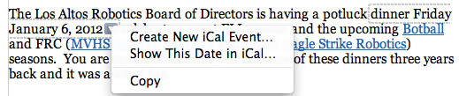
Low-level information extraction
Is now available and popular in applications like Apple or Google mail, and web indexing
Often seems to be based on regular expressions and name lists
Notes:
low-level information extraction:
mail programs extracting times, dates, phone numbers, events
these are specialized kinds of relations
done using regular expressions

Slide 85
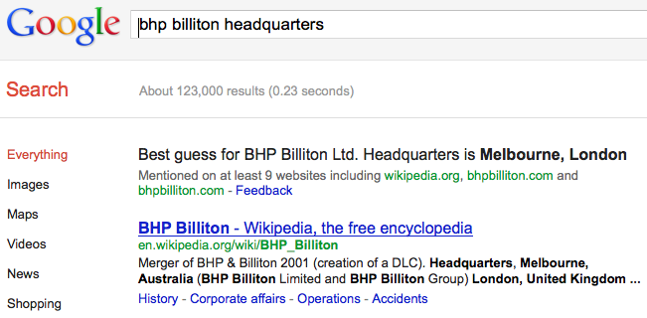
Low-level information extraction
Notes:
low-level information extraction:
mail programs extracting times, dates, phone numbers, events
these are specialized kinds of relations
done using regular expressions

Slide 86

Why is IE hard on the web?
A book,
Not a toy
Title
Need this
price
Notes:
this task is actually a surprisingly difficult task
you might think, how hard can it be: you look at the web page, find out how much, … but there's actually a lot of subtlety in getting it right
here's a product web page -- it's probably pretty obvious to you guys that this is a book, right? but for the computer, it's sort of subtle to tell this
because although the top-level category is "English Books” it's inside subcategory "Toys" -- you might think it's a toy
that's what's more common on shopping sites: if you're on a site that sells home furnishings, and you're in a subcategory "flatware", you assume that a product you see there is an instance of flatware
the title isn't labeled as a title, it's just bold and big font
and then prices -- very typically you see multiple prices
here, prices for different countries
also: list price vs. our price, or previously vs. marked down
somehow you need to figure out that this is the price you want
so to do this with accuracy over different websites is quite tough

Slide 87
Why doesn’t text search (IR) work?
What you search for in real estate advertisements:
Town/suburb. You might think easy, but:
Real estate agents: Coldwell Banker, Mosman
Phrases: Only 45 minutes from Parramatta
Multiple property ads have different suburbs in one ad
Money: want a range not a textual match
Multiple amounts: was $155K, now $145K
Variations: offers in the high 700s [but not rents for $270]
Bedrooms: similar issues: br, bdr, beds, B/R
Notes:
why did the text search engine work so badly?
not only does it not give you geocoding, open house planning
couldn't even successfully deliver basic functionality of search
if you want to search for property, what do you care about?
you probably care about size (# bedrooms), price range, location
none of those are well supported by basic text search
you might think town or suburb would work OK -- and it is the one that comes closest
but still lots of problems:
mention location of real estate office
45 minuts from Parramatta
multiple locations in a single ad
prices -- people want to search for price range, and text search doesn't do that
multiple prices: was X, now Y
rent vs buy

Slide 88
Named Entity Recognition (NER)
A very important sub-task: find and classify names in text
Notes:
so let's talk a bit more about NER and how it's evaluated, and then we'll talk about two approaches for doing it
so I already defined NER. you have a piece of text, and you want to:
1. find things that are names: European Commission, John Lloyd Jones, etc.
2. give them labels: ORG, PERS, etc.
note that in this particular example "Thursday" was not labeled

Slide 89
Named Entity Recognition (NER)
The uses:
Named entities can be indexed, linked off, etc.
Sentiment can be attributed to companies or products
A lot of IE relations are associations between named entities
For question answering, answers are often named entities.
Concretely:
Many web pages tag various entities, with links to bio or topic pages, etc.
Reuters’ OpenCalais, Evri, AlchemyAPI, Yahoo’s Term Extraction, …
Apple/Google/Microsoft/… smart recognizers for document content
Notes:
First, let's define NER!
go through pages, recognize the names of things: "Bill MacCartney", "Stanford University"
the people who came up with this task had a rather precise, philosophically motivated meaning in mind
entity: a discrete, actual thing: Bill MacCartney, but not calcium carbonate or Tuesday or Viagra
named entity: an entity with a name, in a philosophical, Kripke-like sense
(this water bottle is an entity, but not a NAMED entity)
but in practice the definition has been expanded quite a bit in later work
we routinely include dates & times, proteins, drug names
but still, loosely, things that have a name
but NOT references to entities which are not names: "this university", "it”
first task in NER: identifying occurrences of named entities
looking for capital letters is a really good clue! at least in English! but not so much in Hebrew, Chinese, ... non-Latinate alphabets also doesn't really work in German -- all nouns are capitalized!
so that's a pretty useful base-level task -- widely deployed and used
you've probably seen web pages that do this
e.g. financial web sites often mark up stock symbols, names of companies
Microsoft has done work with this, smart tags, entities tagged with metadata
Reuters has web service OpenCalais, you send them docs, they send back NER markup

